Slide 1
HST 103: History of Bangladesh
Topic 6: Famines in Bengal
(The Great Bengal Famine of 1770)

Slide 2
What is Famine?
Severe and prolonged starvation among a substantial part of the population - acute malnutrition and eventually death – two most severe famines in Bengal occurred in 1770 and 1943 – there were many others but these were the worst
Main causes of famines in Bengal
Extreme exploitation of farmers, mismanagement of food supply, natural disaster and others – ‘Entitlement Failure’ (Amartya Sen’s theory)

Slide 3
Why do Famines occur
The FAD (Food Availability Decline) theory of famine: Before, the assumption was that the central cause of all famines was a decline in food availability by reason of decline in food production or disruption of food distribution. This theory, in its basic form, suggests that if there's not enough food to go around, people will starve.
Amartya Sen challenged the prevailing ‘FAD hypothesis’.
According to Amartya Sen the more proximate cause is so-called “entitlement failure,” which can occur even when there is no decline in food production.

Slide 4
THE GREAT BENGAL FAMINE OF 1770
The Great Bengal Famine of 1770 took place between 1769 and 1773.
Apart from Bangladesh (then Eastern Bengal), Bihar, Orissa, Jharkhand and Western Bengal were also severely affected by this famine.
A partial shortfall in crops, considered nothing out of the ordinary, occurred in 1768 and was followed in late 1769 by more severe conditions. By September 1769, alarming reports were coming in which were ignored by company officers.
By the beginning of 1770, there was scarcity of food on a wide scale and people began to die from starvation
It is estimated to have caused the deaths of 10 million people.
The famine is usually attributed to the rule of the British East India Company
The Bengal famine of 1770 lasted till 1773

Slide 5
CAUSES
Natural factors:
Crop failure: There was a significant failure of rice crops in 1768 and again in 1769, which drastically reduced food availability
Monsoon failure and drought: The famine was precipitated by a severe failure of the South-East monsoon in 1769, leading to prolonged drought conditions that devastated agriculture.
Epidemics: A smallpox epidemic in 1768 further weakened the population, compounding the effects of starvation caused by crop failure and drought
Heavy rainfall in 1770 worsened the situation rather than alleviating it. After the severe drought and crop failures of 1768-1769, the monsoon rains arrived in 1770. The heavy rainfall led to flooding and waterlogging, which further destroyed any remaining crops and made agricultural recovery difficult.
The existing revenue system of land and activities of middlemen in the food grain market further deteriorated the situation.

Slide 6
Administrative Causes
British East India Company got ‘Diwani rights’ over Bengal, Bihar and Orissa in 1765. They introduced Dual Government System.
The Dual Government System was a system where two authorities ruled a single region. British East India Company Controlled Revenue (Diwani) – tax collection and finance, On the other hand Nawab of Bengal had the Nizamat (Administration) – law, order, justice. So, the British had the power and money but no responsibility while the Nawab had responsibility without resources.
The Company increased the tax to 50 percent of the production
In Bengal, they collected land tax as well as trade tariffs
The peasants were unable to maintain the safety nets of storing crops for unfortunate situations
The peasants were forced to cultivate cash crops such as indigo and poppy
This reduced the production of edible crops to a large extent.

Slide 7
Consequences
Approximately 10 million people died of starvation
A large number of the population left their residences in search of food - resulting in depopulation of villages
Cultivable lands were abandoned
The silk and handloom industries were the pride of Bengal during Mughal imperial rule. But both industries were damaged because of the famine. The labor force of these industries was reduced to half because of the disaster. As a result, the production in these industries declined and the market price of the products went high. One survey in Rajshahi district said that between 1770 and 1771 silk production decreased to 55% compared to its earlier production. The labor force of the silk industry was reduced to 55%. The same goes for handloom industries as well.
The decline of the law and order of Bengal was another consequence. Some people left their old professions and became Dakats and robbers to survive.
Due to the shortfall of income, the Company further raised the taxes
One indirect Consequences of the Famine of 1770 was the abolition of the dual Government system.

Slide 8
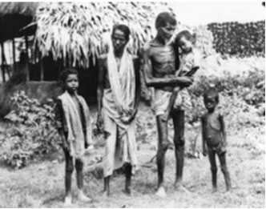
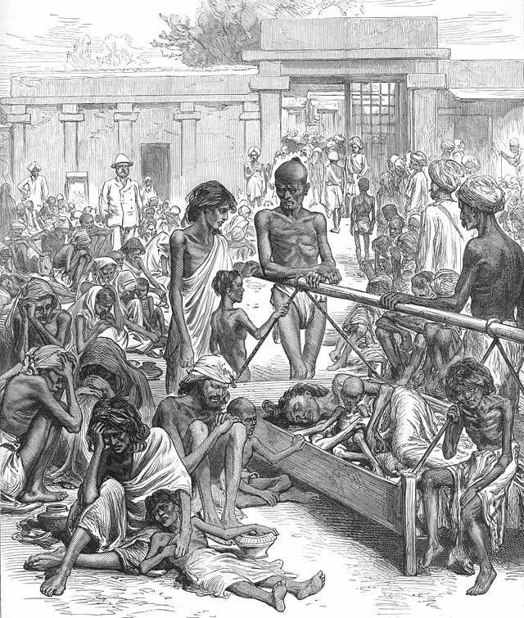
Visualization of the Bengal Famine of 1770

